Slide 1


Helping People Adapt as AI Reshapes Roles
Prepared by Challenger, Gray & Christmas
December
Notes:
DAVID

Slide 2

WHAT WE KNOW
Employees may have their role eliminated due to advances in AI
This may lead to uncertainty by these individuals on what to do next
Organizations want to make sure these individuals are assisted to find their next new role or career move
Notes:
David
We created this slide to get a better understanding of what dsm-Firmenich is looking for from an outplacement provider
Based on the RFP and our research
We know....
READ ALL POINTS *Pause
Were we able to capture this accurately? Did we miss anything?

Slide 3

How we can Help
We will provide an evaluation of their current role along with the projected outlook.
We will suggest transferable roles along with evaluations on those matches. We will also look at the projected outlook/viability for those roles.
Our coaches will work with each individual to evaluate this information and make a plan of action
If a change is needed, we will suggest courses/certifications (if appropriate)
Notes:
Andy

Slide 4
Data doesn’t lie – We will look at the following:
Projected Outlook
We look at the projected outlook for each position to determine the viability
Job Postings
Are job postings for this role going up, down or staying stagnant. This information can help inform whether a change is needed
Salary Trends
Similar to Job Posting data, are salaries for the role increasing or decreasing?
Notes:
Andy

Slide 5
Career Shift Journey
1. Questionnaire
3. Skills mapping
5. Market Analysis
We discover who they are and what their skills are
We map to 5 to 10 other positions or careers to consider
Each client receives a market analysis of each option as a starting point
2. Job Analysis
4. Jobs Viability
6. Expert coaching
We look at their current career and its projected outlook
We look at the projected outlook for each, if there are any skills gap and what is needed to bridge that gap
A career change specialist walks them through the options
Notes:
Andy
COMPANY shares client information: Challenger being able to contact job seekers directly is critical to activation and key to successful transitions.
Challenger outreach team contacts job seekers: Challenger uses multiple touchpoints to make contact and to onboard job seekers.
Client completes assessment: A fast-start begins by understanding where the client is at, enabling them to prepare for next steps and to triage immediate needs.
Client is carefully matched with a job search coach: varies by program level, this is where the client begins to be surrounded by a team of experts, with their coach at the lead.
Client gains access to Challenger CareerSuite: where they can start by registering for live webinars, take assessments, update their personal branding, practice interviews and much more
Resume and LinkedIn review begins: varies by program level, clients are surrounded by teams of experts to present themselves in a way that stands out and gains attention
Client and coach create a job search strategy: Through an in-depth consultation, their coach builds a personalized roadmap tailored to their career goals and skillset to set up a focused, effective search
We work together: with unlimited coaching and access to Challenger CareerSuite, the client’s plan is put to action. We help with direction on personal branding, networking, and interview prep. And importantly, we are there for our clients. Our coaches keep clients on track and moving forward.
Client secures job! We help clients negotiate the best deal possible for a role they’re excited about

Slide 6
What does the process look like?
Career transitions are one of the most stressful times in a person’s life. Offering this extra assistance shows your values in action and makes your company all the better for it.
Employees take a questionnaire:
We gather information on who they are, including their work history and their goals
We ask if they are interested in exploring other careers (note, we can provide the Career Shift program information even if they don’t select this, but this allows us to gage their interest.
We confirm we can help them with this, and ask if there is anything in particular they want to explore, while also reassuring them that we can help them with that part if they are unsure!
Notes:
David
This is what customers and clients receive through Outplacement.
It’s what Challenger provides, which is generally much more holistic, personalized and value-driven than what others in the market provide.
Further in the presentation we’ll show how we address both of these groups. The Customer journey and the Client journey.

Slide 7
What does the process look like?
After the questionnaire is submitted:
As part of the diagnostic stage, we draft an initial assessment along with some potential career mapping.
This will be given to the coach to review with the client, with the possibility that we make a user-friendly format for the client as well.
The assessment will include an analysis of their current role, along with the projected outlook of the role. See the next slides for an example of the data we will provide for the current role
Notes:
David
This is what customers and clients receive through Outplacement.
It’s what Challenger provides, which is generally much more holistic, personalized and value-driven than what others in the market provide.
Further in the presentation we’ll show how we address both of these groups. The Customer journey and the Client journey.

Slide 8
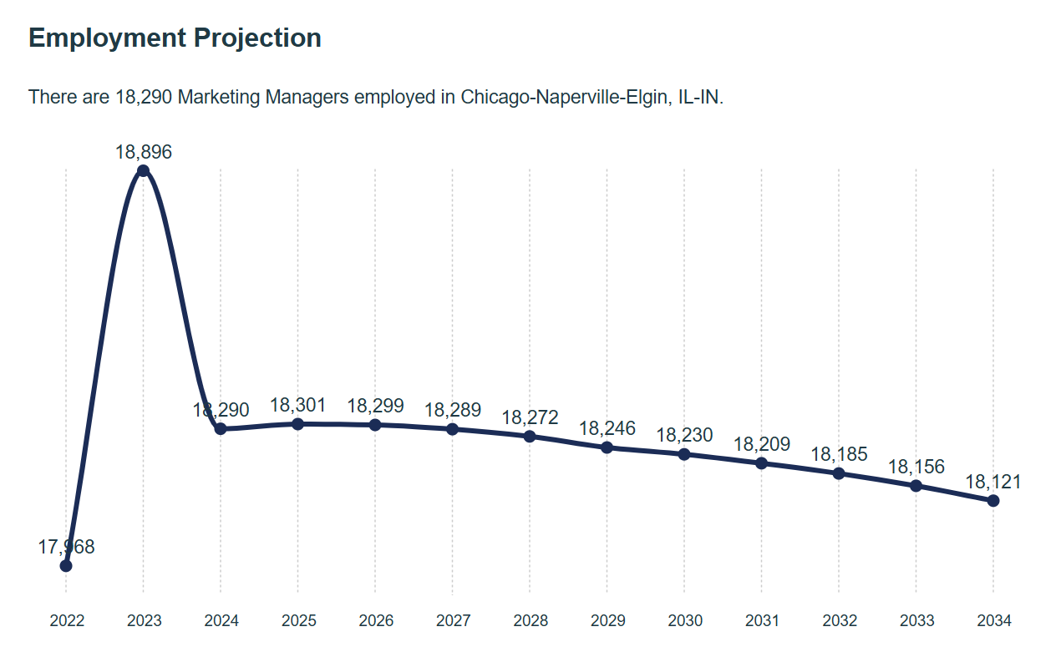
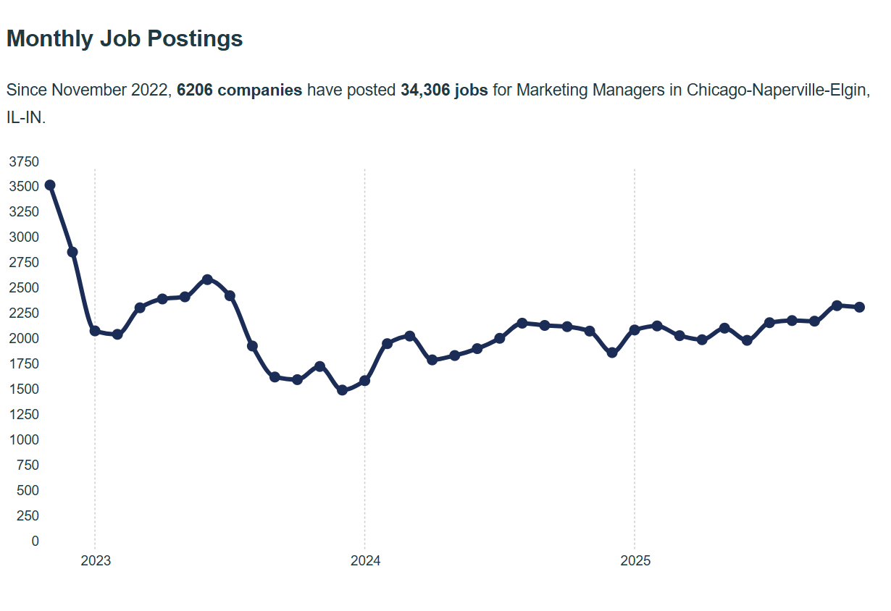

Slide 9
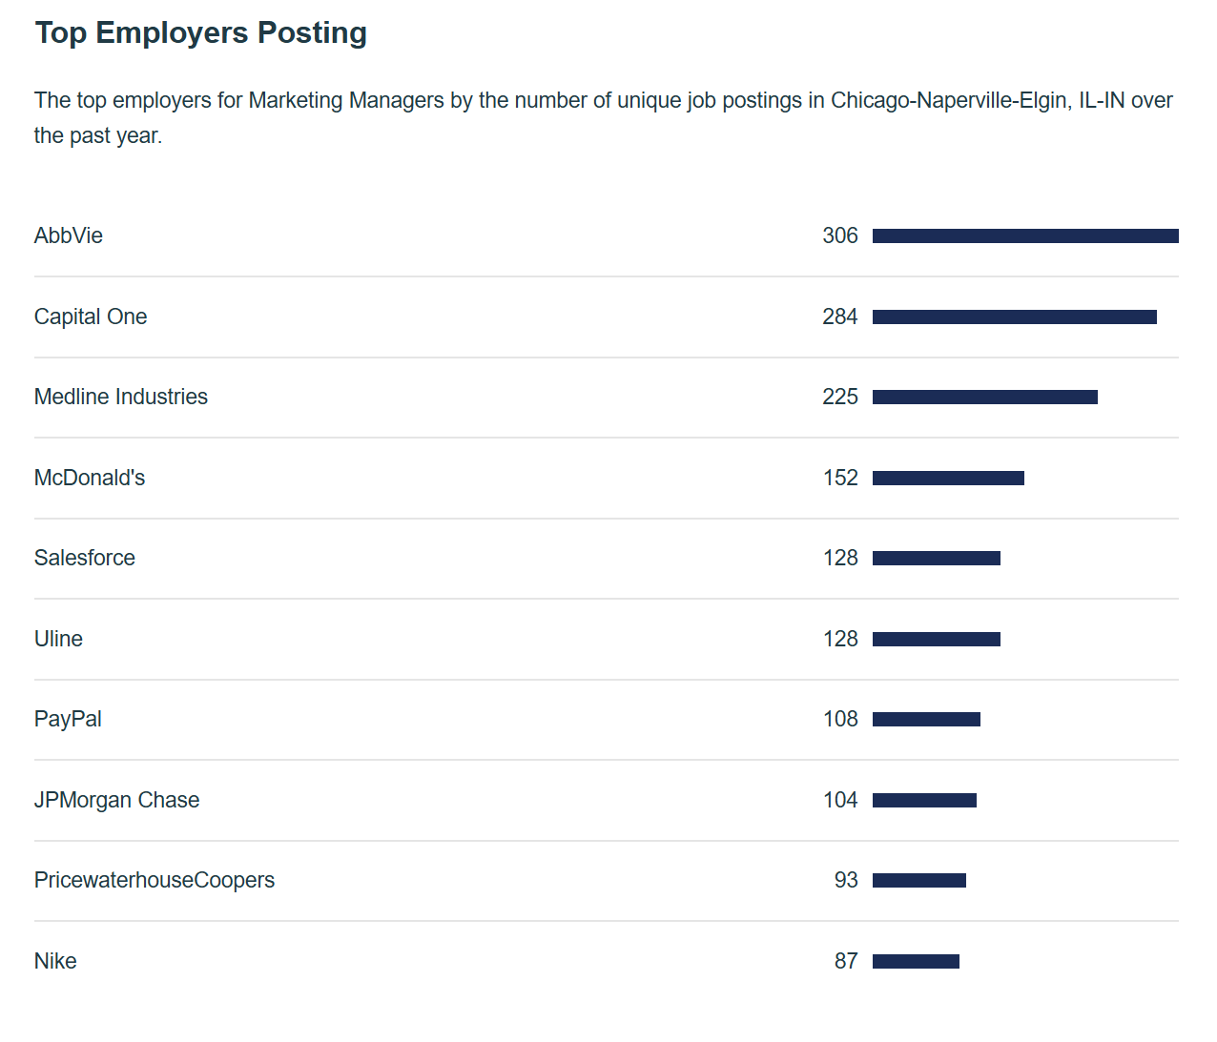

Slide 10
Career Shift Analysis
After the questionnaire is submitted:
We will also provide possibilities for 5 to 10 other potential career matches based on their hard and soft skills and other background skills or education.
For each we will provide the growth rate of the role, salary ranges, training length required, and why it is a match.
Notes:
David
This is what customers and clients receive through Outplacement.
It’s what Challenger provides, which is generally much more holistic, personalized and value-driven than what others in the market provide.
Further in the presentation we’ll show how we address both of these groups. The Customer journey and the Client journey.

Slide 11
Example:
⭐ Top 10 Future-Ready Roles
(Each role below includes: job growth forecast, salary insights, and required certifications or degrees)
Digital Banking Support Specialist
Why This Role Matches:
Customer service strengths translate directly
Banking knowledge is highly transferable
Requires digital skills that can be acquired quickly with training
📈 Job Growth Forecast:
14–17% growth over the next decade
Driven by expansion of online banking, chat-based support, and AI-assisted customer service teams
💵 Median Salary Range:
$48,000–$62,000/year (U.S. national average)
Higher in major metro areas or fintech companies: $60,000–$72,000+
🎓 Recommended Certifications:
Customer Service Specialist (CSS) — ICSA
Salesforce CRM Administrator (Entry Level)
Digital Banking Certificate — ABA (American Bankers Association)
Google IT Support or Digital Support Certificate (optional but helpful)

Slide 12
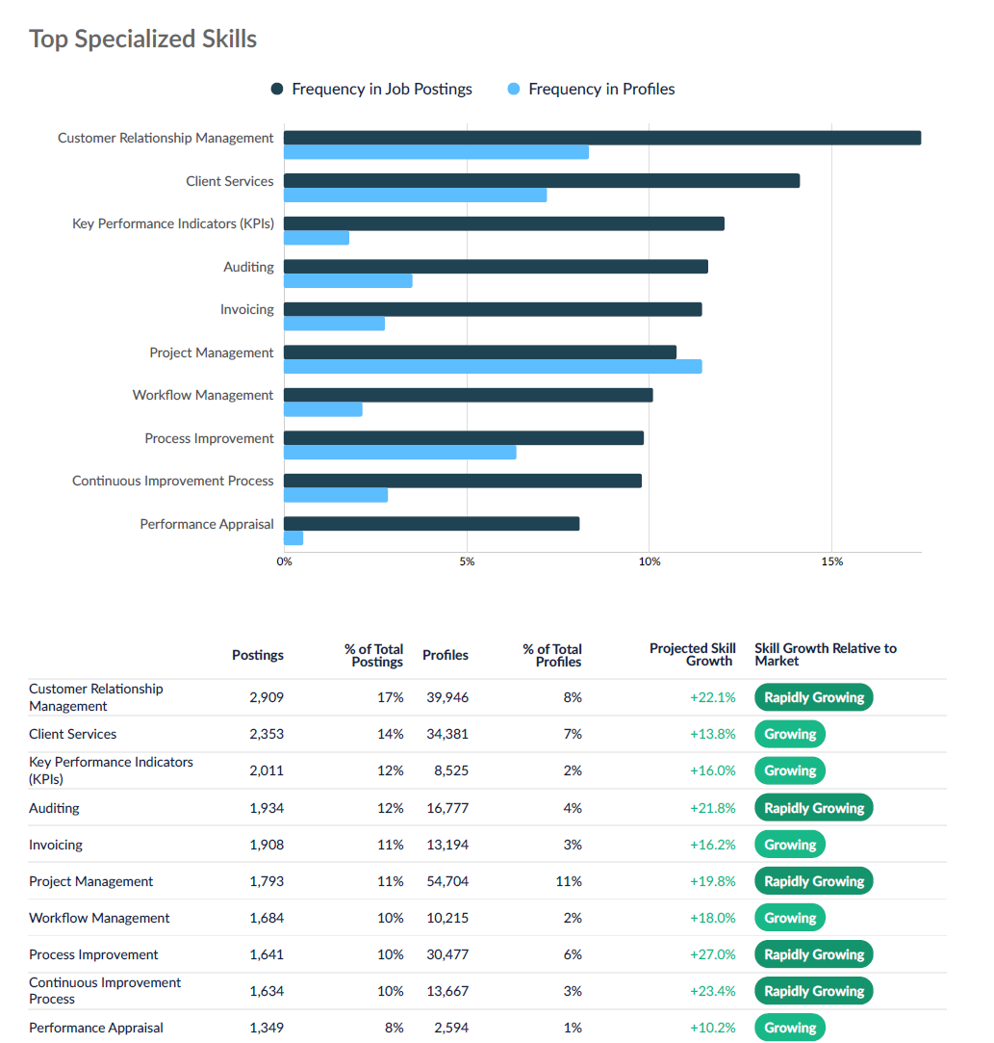
Additional CareerSuite Tools
In addition to the market analysis, clients and coaches can go on CareerSuite
to explore other options
Job Analysis – For any job (either their current, or other jobs they want to consider), they will be able to see information on the projected outlook (likely as a whole or by region), along with number of job postings, salary levels, employers hiring, and top skills for the job (see prior slides 8 and 9 for some of the data, as well as the skills data to the right).
Notes:
David
The customer journey…we act as a true extension of your HR team, supporting you before, during, and after a workforce transition. We provide tailored planning, training and support through both small and large workforce transitions
We also offer custom workshops for HR teams and managers on topics such as managing stress, leading through change, and supporting remaining employees, helping to preserve morale and productivity across the organization.

Slide 13
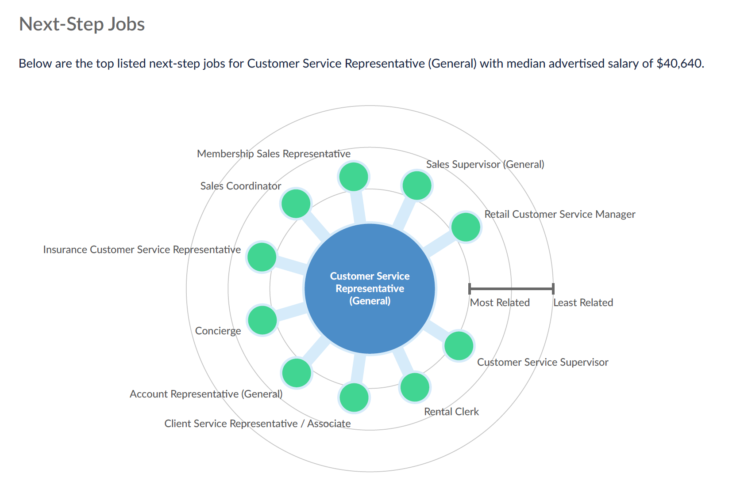
Additional CareerSuite Tools
In addition to the market analysis, clients and coaches can go on CareerSuite
to explore other options
They will also be able to see Next Step Jobs and a similar tool for Feeder Jobs
Notes:
David
The customer journey…we act as a true extension of your HR team, supporting you before, during, and after a workforce transition. We provide tailored planning, training and support through both small and large workforce transitions
We also offer custom workshops for HR teams and managers on topics such as managing stress, leading through change, and supporting remaining employees, helping to preserve morale and productivity across the organization.

Slide 14
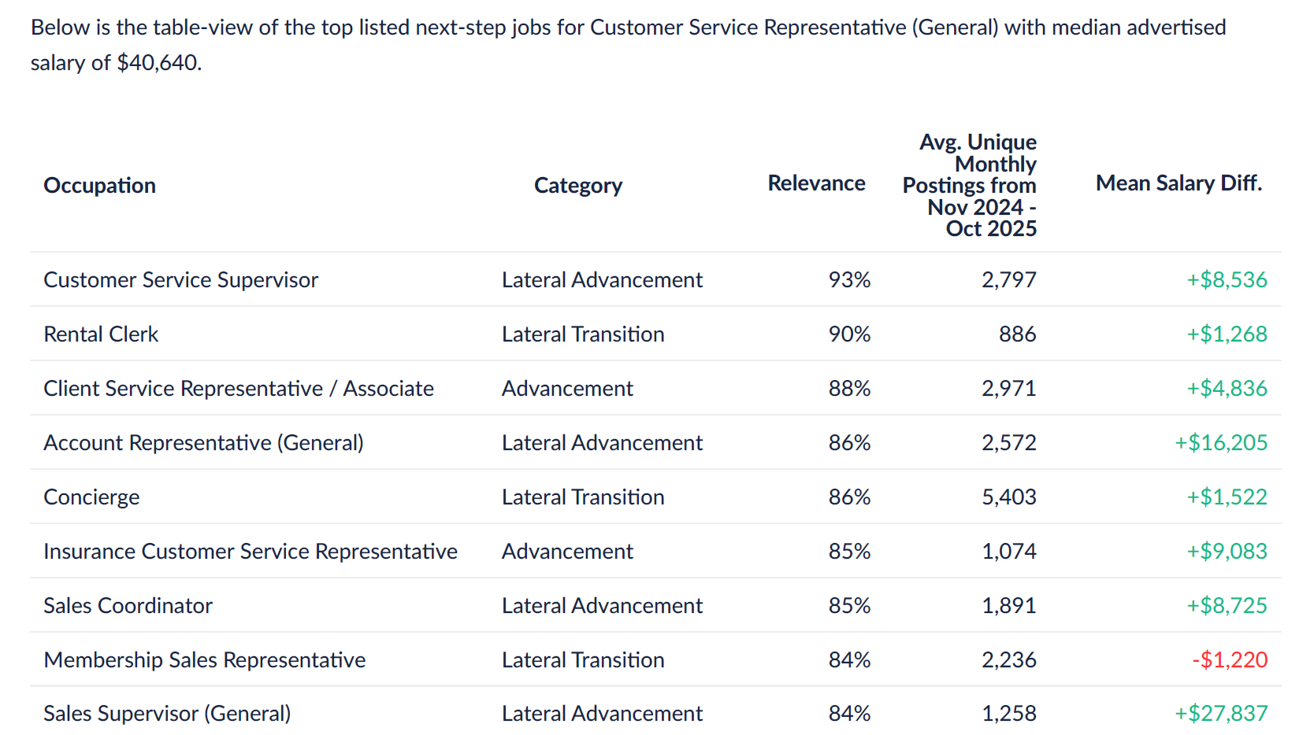
Additional CareerSuite Tools
In addition to the market analysis, clients and coaches can go on CareerSuite
to explore other options
They will also be able to see Next Step Jobs and a similar tool for Feeder Jobs
Notes:
David
The customer journey…we act as a true extension of your HR team, supporting you before, during, and after a workforce transition. We provide tailored planning, training and support through both small and large workforce transitions
We also offer custom workshops for HR teams and managers on topics such as managing stress, leading through change, and supporting remaining employees, helping to preserve morale and productivity across the organization.

Slide 15
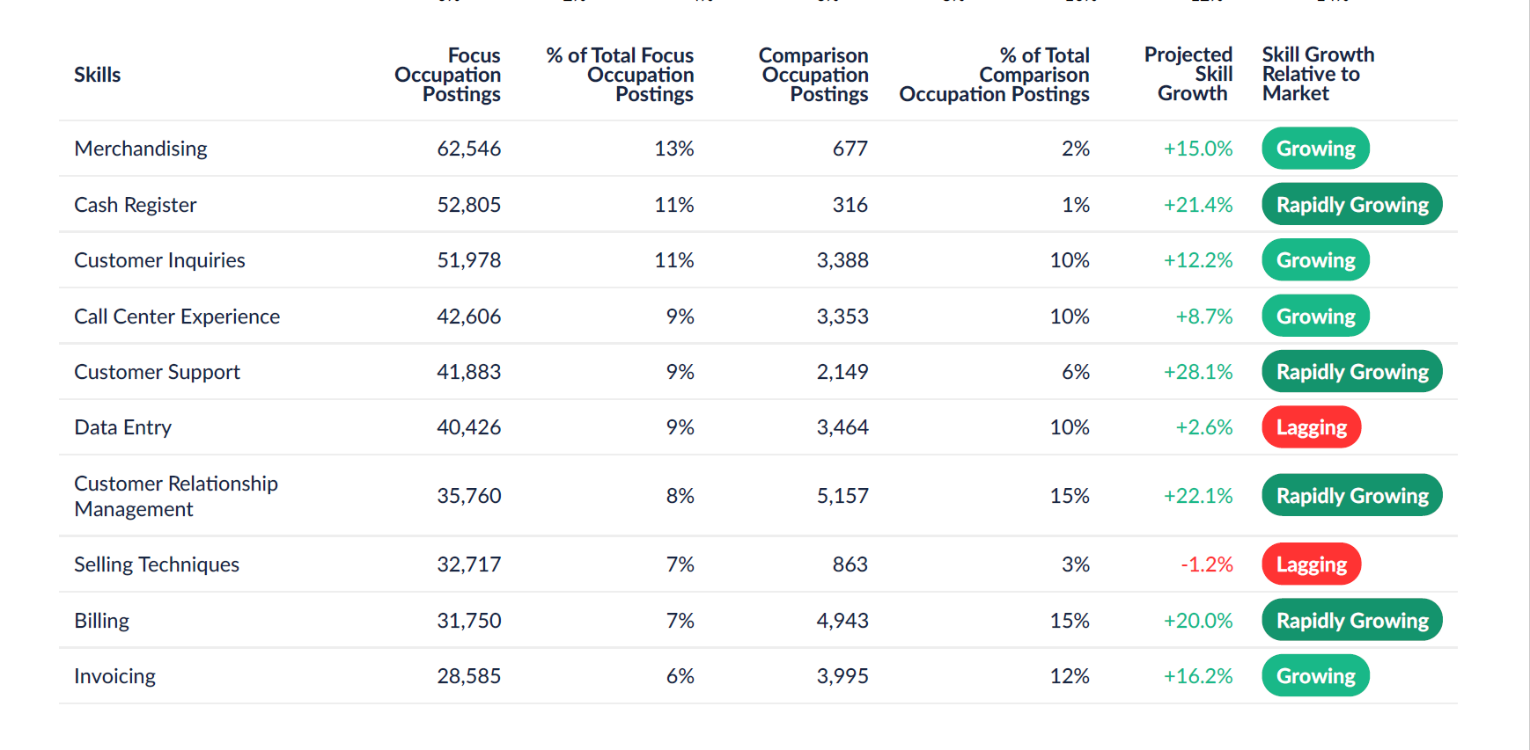
Additional CareerSuite Tools
In addition to the market analysis, clients and coaches can go on CareerSuite
to explore other options
And what skills are growing and lagging.
Notes:
David
The customer journey…we act as a true extension of your HR team, supporting you before, during, and after a workforce transition. We provide tailored planning, training and support through both small and large workforce transitions
We also offer custom workshops for HR teams and managers on topics such as managing stress, leading through change, and supporting remaining employees, helping to preserve morale and productivity across the organization.

Slide 16
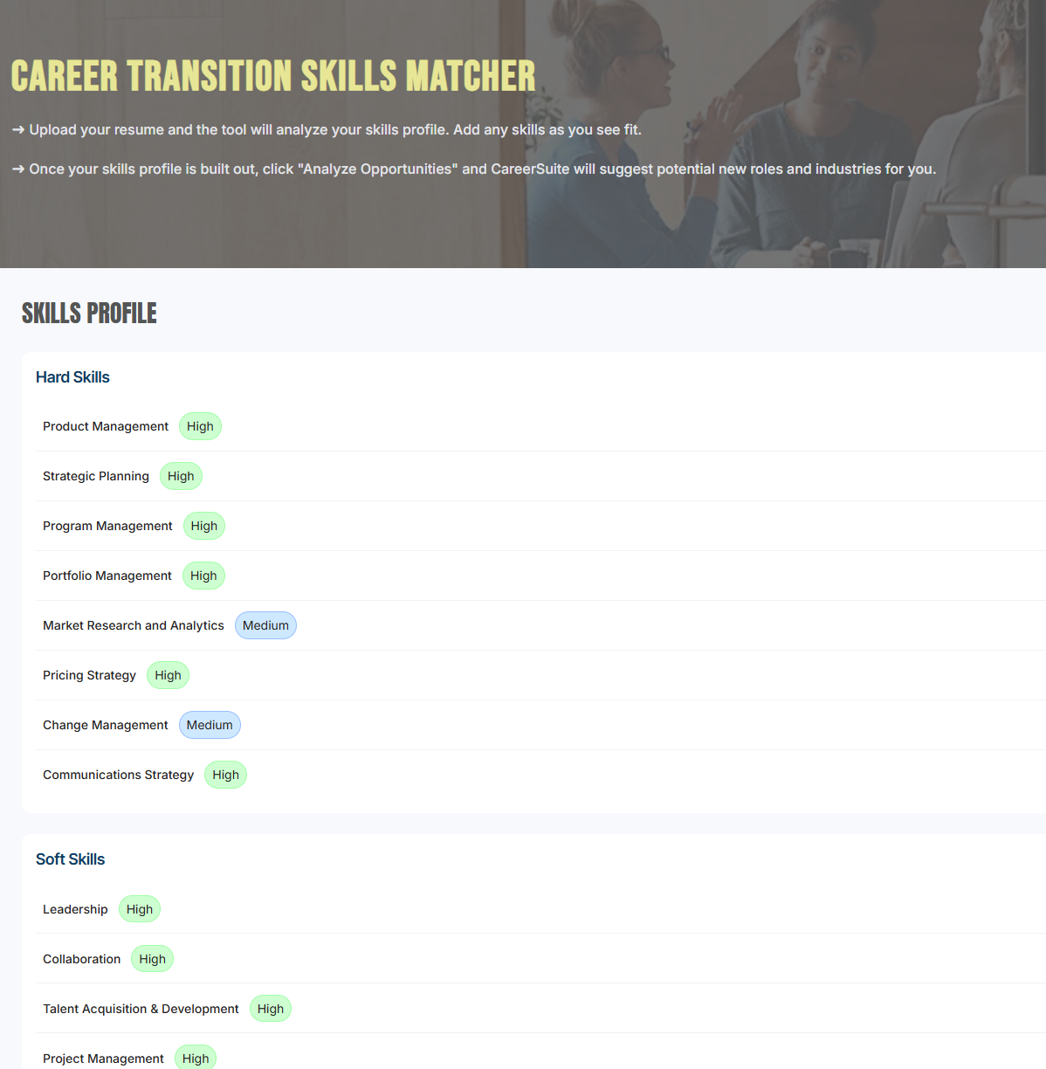
Additional CareerSuite Tools
We will modify the Career Transition Skills Matcher
Job Analysis – For any job (either their current, or other jobs they want to consider), they will be able to see information on the projected outlook (likely as a whole or by region), along with number of job postings, salary levels, employers hiring, and top skills for the job (see prior slides 8 and 9 for some of the data, as well as the skills data to the right).
Notes:
David
The customer journey…we act as a true extension of your HR team, supporting you before, during, and after a workforce transition. We provide tailored planning, training and support through both small and large workforce transitions
We also offer custom workshops for HR teams and managers on topics such as managing stress, leading through change, and supporting remaining employees, helping to preserve morale and productivity across the organization.

Slide 17
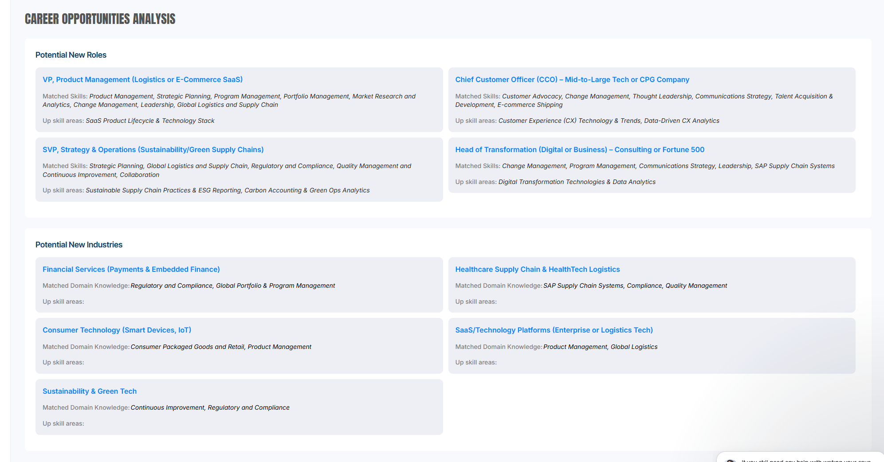
Additional CareerSuite Tools
In addition to the market analysis, clients and coaches can go on CareerSuite
to explore other options
Job Analysis – For any job (either their current, or other jobs they want to consider), they will be able to see information on the projected outlook (likely as a whole or by region), along with number of job postings, salary levels, employers hiring, and top skills for the job (see prior slides 8 and 9 for some of the data, as well as the skills data to the right).
Notes:
David
The customer journey…we act as a true extension of your HR team, supporting you before, during, and after a workforce transition. We provide tailored planning, training and support through both small and large workforce transitions
We also offer custom workshops for HR teams and managers on topics such as managing stress, leading through change, and supporting remaining employees, helping to preserve morale and productivity across the organization.

Slide 18
Info on each position
In addition to the market analysis, clients and coaches can go on CareerSuite
to explore other options
Job Analysis – For any job (either their current, or other jobs they want to consider), they will be able to see information on the projected outlook (likely as a whole or by region), along with number of job postings, salary levels, employers hiring, and top skills for the job (see prior slides 8 and 9 for some of the data, as well as the skills data to the right).
They will be able to favorite/save each role they are interested in, so that they can create a shortlist.
Notes:
David
The customer journey…we act as a true extension of your HR team, supporting you before, during, and after a workforce transition. We provide tailored planning, training and support through both small and large workforce transitions
We also offer custom workshops for HR teams and managers on topics such as managing stress, leading through change, and supporting remaining employees, helping to preserve morale and productivity across the organization.

Slide 19
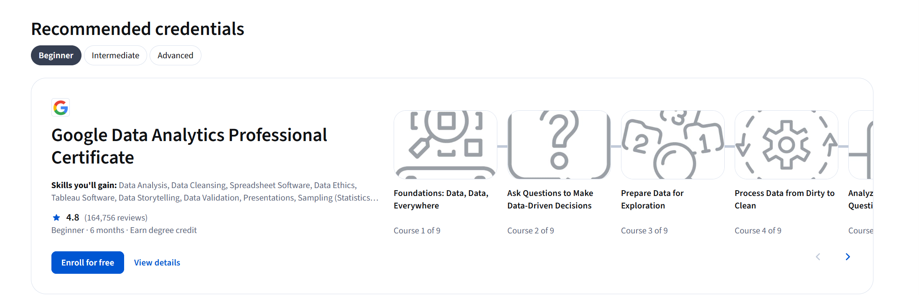
Need for upskilling?
For roles where there is a need for upskilling, we will map to suggested courses.
Notes:
David
The customer journey…we act as a true extension of your HR team, supporting you before, during, and after a workforce transition. We provide tailored planning, training and support through both small and large workforce transitions
We also offer custom workshops for HR teams and managers on topics such as managing stress, leading through change, and supporting remaining employees, helping to preserve morale and productivity across the organization.

